Slide 1
SharePoint Data Access
Server Side
Access data in SharePoint lists from code running
on the SharePoint server
Notes:
Microsoft invested a considerable amount in SharePoint 2010 on ways to get data out of SharePoint lists. New to SharePoint is LINQ integration. LINQ for SharePoint is used for querying and joining lists as well as creating and updating items. In this module you will learn how to setup LINQ for SharePoint and query lists as well as use the more traditional methods of working with SharePoint data using CAML, SPQuery and SPSiteDataQuery.

Slide 2
Agenda
CAML
SPQuery & SPSiteDataQuery
LINQ Primer
LINQ to SharePoint

Slide 3
CAML:
Collaborative App. Markup Language
Think of CAML as “SharePoint XML”
Original data access method on the server
Similar to creating T-SQL statement but with XML
Still used in SharePoint 2010 in server-side solutions & client object model queries
Full SDK reference on MSDN:
  http://msdn.microsoft.com/en-us/library/ms462365.aspx
Notes:
Collaboration Application Markup Language (CAML) is the schema defined and used by SharePoint. Introduced in SharePoint 2003, it is used to define things like lists, Features, workflows and also to query SharePoint lists.
It is similar to T-SQL in that developers use it to express the fields to SELECT, the WHERE cause for filtering data and how to sort the result set using ORDERBY. It is still the fastest way to access data stored within SharePoint lists, even with the introduction of LINQ for SharePoint.

Slide 4
Agenda
CAML
SPQuery & SPSiteDataQuery
LINQ Primer
LINQ to SharePoint

Slide 5
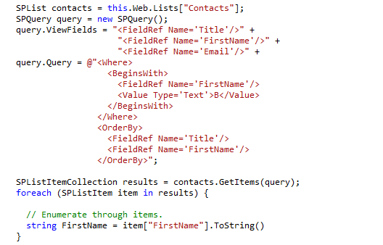
SPQuery
Executes query against a single list
Developer must parse together CAML fragments
Access to columns is not strongly typed
Notes:
Querying a list for specific items that meet a certain criteria can be done using the Microsoft.SharePoint.SPQuery object. The SPQuery object exposes a Query property that accepts a CAML fragment, which defines the query to be performed. A ViewFields property defines the fields to return. The following code shows a simple query run against a list.
The ViewFields property accepts a CAML fragment containing a series of FieldRef elements. Each FieldRef element has a Name attribute that specifies the name of the list field to return from the query. Note that the Name attribute must contain the name of the field as it is defined in the schema.xml file for the list definition and not simply the display name of the field.
To create a query, you must construct a CAML fragment properly, defining the items to return from the list. At the highest level, the CAML fragment may contain Where, OrderBy, and GroupBy elements. Inside each of these elements, you can use additional CAML elements to specify conditions. Table 9-1 contains a complete list of CAML elements that may be used to create a query, and Listing 9-2 shows the basic form of the CAML query.

Slide 6
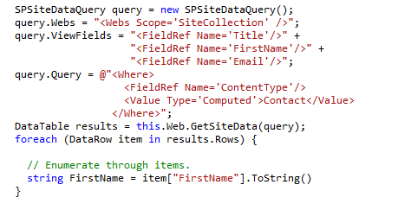
SPSiteDataQuery
Similar to SPQuery with respect to CAML parsing and no strongly typed access
Can execute query against multiple lists and aggregate results
Queries scoped to level of the site collection
Can create performance problems if used incorrectly
Notes:
If you want to query multiple lists within a site collection simultaneously, then you can make use of the Microsoft.SharePoint.SPSiteDataQuery object. Like the SPQuery object, the SPSiteDataQuery object has Query and ViewFields properties. In addition to these fields, the SPSiteDataQuery object also has Lists and Webs properties. The Lists property is used to specify the lists within the site collection that should be included in the query. The Webs property is used to determine the scope of the query.
The Lists property is a CAML fragment that can take several forms to specify the lists to include in the query. Setting the property to <Lists ServerTemplate=[value]/> limits the query to lists of a certain server template. For example, type 106 is a calendar. Setting the property to <Lists BaseType=[value]/> limits the query to lists of a certain BaseType. Setting the property to <Lists Hidden=’true’/> includes hidden lists in the query. Setting the property to <Lists MaxListLimit=[value]/> limits the query to considering no more than the specified number of lists.
The Webs property is a CAML fragment that must either be <Webs Scope=’SiteCollection’/> or <Webs Scope=’Recursive’/>. SiteCollection includes all lists in the site collection while Recursive includes only those lists in the current site or subsites beneath the current site.

Slide 7
Why LINQ?
What's the problem?
  Data access programming differs for each type of data
  Data access programming often lacks type safety
  Programming language have no native query syntax
LINQ is the solution
  LINQ = Language Integrated Query
  Added to .NET Framework in version 3.0
  C# and VB languages extended to support LINQ syntax
Notes:
LINQ has been added to the .NET Framework in version 3.0. With LINQ to SQL you can query data stored in SQL Server databases and with LINQ to XML your can query XML data. But until now there was no way to query SharePoint data using LINQ.
SharePoint 2010 comes with a LINQ provider that allows querying SharePoint data.

Slide 8
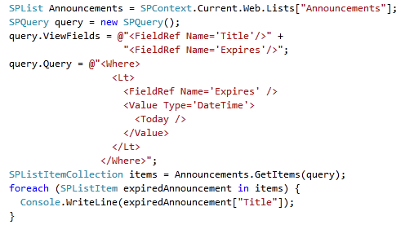

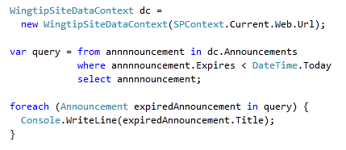

Total Makeover for Your Data Access Code
Before
LINQ
After
LINQ
Notes:
In SharePoint 2007 you had to retrieve data using CAML queries. With LINQ to SharePoint you can build LINQ queries, which makes your code more readable. Behind the scenes LINQ will generate a CAML query to retrieve the data.

Slide 9
What Types of Data Does LINQ Support?
LINQ has built-in support to access .NET objects
  Support based on generics interface IEnumerable<T>
  LINQ adds support to query, filter, order and aggregate
External data accessible through LINQ providers
  .NET team created providers for XML and SQL Server
  SharePoint team created LINQ to SharePoint provider
  Custom providers used to access other types of data
Notes:
LINQ stands for .NET Language-Integrated Query. It is a set of extensions to the .NET Framework that encompass language-integrated query, set, and transform operations. It extends C# and Visual Basic with native language syntax for queries and provides class libraries to take advantage of these capabilities.
LINQ defines a set of standard query operators that allow traversal, filter, and projection operations to be expressed in a direct yet declarative way in any .NET-based programming language. The standard query operators allow queries to be applied to any IEnumerable<T>-based information source.
External data is now accessible through LINQ provider:
LINQ to Objects
LINQ to SQL
LINQ to XML
Custom providers can be written to access other types of data.

Slide 10
Fundamentals of LINQ Syntax
Generic Collection Classes
The IEnumerable<T> Interface
LINQ Extension Methods
Lambda Expressions
LINQ Query Expressions
Type Inference and the var keyword
Query Composition
Grouping and Aggregation

Slide 11


Generic Collection Classes
.NET 1.0 introduced IEnumerable collections
  Allows for enumeration using foreach syntax
  Collection item based on System.Object which is not type safe
.NET 2.0 introduced generic collections and type safety
  Generics types in System.Collection.Generics namespace
  Collection classes such as List<T> allow you to specify type
  Allows you to create collections with type safety enforced
Notes:
.NET 1.0 introduced the IEnumerable collections that allowed for enumerating collections using the foreach syntax.
.NET 2.0 introduced generic collections and type safety. By defining collections of type List<T> your can create strongly typed lists of objects that can be accessed by index. It provides methods to search, sort, and manipulate lists.
The foreach statement of the C# language (For Each in Visual Basic) hides the complexity of the enumerators. Therefore, using foreach is recommended, instead of directly manipulating the enumerator.

Slide 12
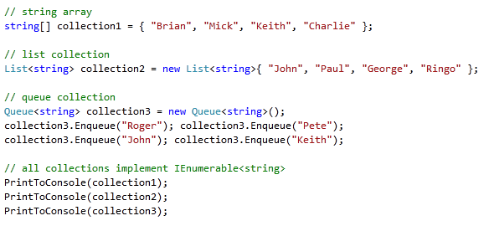

The IEnumerable<T> interface
Provides the foundation for all of LINQ
  Guarantees capability for type safe enumeration
  Automatically implemented by .NET Framework arrays
  Implemented by all generics collection classes
  Implemented by any and all LINQ-friendly collections
Notes:
The IEnumerable<T> interface is the foundation of LINQ to Objects.The IEnumerable<T>offers collections of strongly typed objects and is automatically implemented by .NET generic collection classes.
All of the collections in the System.Collections.Generic namespace support the IEnumerable<T> interface. This makes it possible to query them using LINQ to Objects.
In addition, LINQ queries offer two main advantages over traditional foreach loops:
They are more concise and readable, especially when filtering multiple conditions.
They provide powerful filtering, ordering, and grouping capabilities with a minimum of application code.

Slide 13
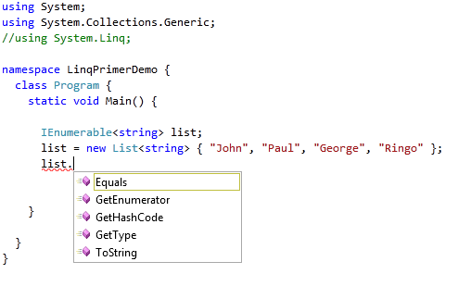
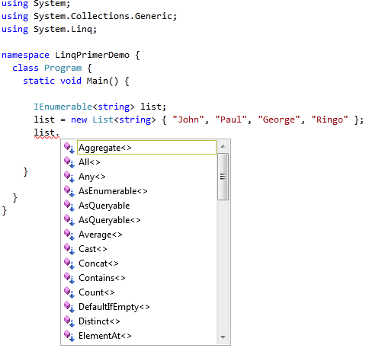
LINQ Extension Methods
Extension methods feature added to .NET 3.0
  Allows developers to extend existing types
  LINQ adds extension methods to IEnumerable<T>
  Make sure to import System.Linq namespace
standard IEnumerable<T> methods
Extension methods added by LINQ
Notes:
.NET 3.0 came with a number of new features, extension methods being one of them. Extension methods enable you to "add" methods to existing types without creating a new derived type, recompiling, or otherwise modifying the original type.
The most common extension methods are the LINQ standard query operators that add query functionality to the existing IEnumerable<T> types. To use the standard query operators, first bring them into scope with a using System.Linqdirective. Then any type that implements IEnumerable<T> appears to have instance methods such as GroupBy, OrderBy, Average, and so on. You can see these additional methods in IntelliSense statement completion when you type "dot" after an instance of an IEnumerable<T> type such as List<T> or Array.

Slide 14
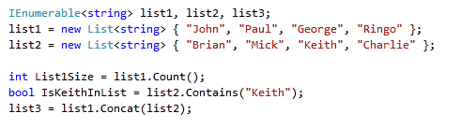
Using LINQ Extension Methods
LINQ extension methods add functionality
  Provides common list-based operations
  Can be used on any IEnumerable<T> collection
Notes:
In short, LINQ extension methods add functionality to any type that implements IEnumerable<T> It provides common list-based operations like Contains, Count, Distinct, GroupBy, OrderBy, Average, and so on.

Slide 15
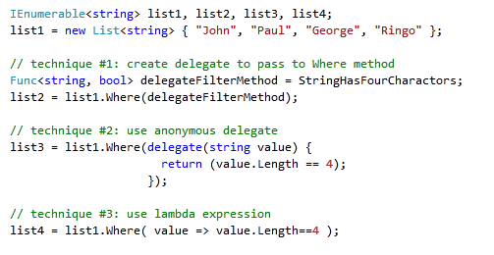

Filtering with the Where extension method
Call to Where uses one of three techniques
  Explicit delegate
  Anonymous Delegate
  Lambda expression
Notes:
LINQ to Objects represents a new approach to collections. In the old way, you had to write complex foreach loops that specified how to retrieve data from a collection. In the LINQ approach, you write declarative code that describes what you want to retrieve.
With LINQ you can filter collections using the Where extension method. A first technique is to create a delegate and pass that delegate to the Where method. This technique requires a method to exist in the code. Many of these methods will only get used in a single call.
To avoid having to develop numerous filter methods, you can use a second technique, which is the technique of using an anonymous delegate. The filtering code delegate is written inline in the Where clause using the delegate keyword.
A shorter notation for anonymous delegates is the use of lambda expressions. A lambda expression is a very concise way to construct the expression tree. The lambdas allow the Where calls to look similar although in fact the type of object created from the lambda is different.

Slide 16
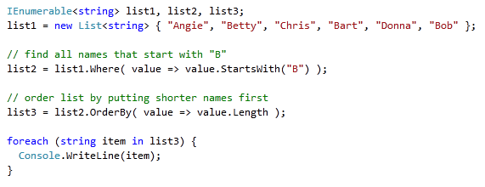
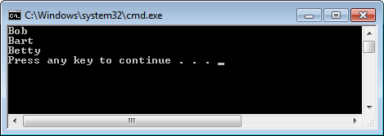
Lambda Expressions
Important to understand when using LINQ
  Name "lambda" makes them seem harder then they are
  Concise syntax to inline (1) parameter list and (2) statement body
Input Parameter(s)
Lambda Operator
Statement Block
read as "value goes into value starts with B"
Notes:
All lambda expressions use the lambda operator =>, which is read as "goes to". The left side of the lambda operator specifies the input parameters (if any) and the right side holds the expression or statement block.

Slide 17
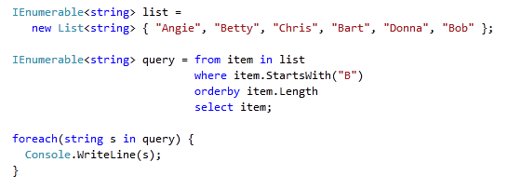

LINQ Query Expressions
LINQ provides syntax for writing queries
  Designed to seem natural, intuitive and readable
computation
range variable
data source
query clauses
projection
Notes:
The type IEnumerable<T> plays two key roles in this code.
The query expression has a data source called list which implements IEnumerable<T>.
The query expression returns an instance of IEnumberable<T>.
Every LINQ to Objects query expression, including the one shown above, will begin with a line of this type:from item in list.
In each case, the data source represented by the variable list must support the IEnumerable<T> interface. The list of strings shown in this example supports that interface.

Slide 18
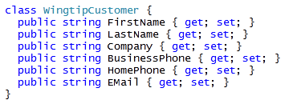
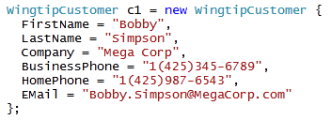
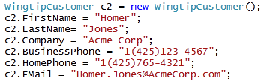
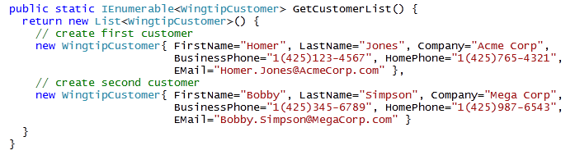
LINQ Support for Custom .NET Objects
new C# 3.0 syntax for automatic properties
new C# syntax for creating and initializing object
designed to replace this old-school syntax
Here is a sample method that returns a LINQ-friendly collection of custom objects
C# 3.0 adds support for automatic properties
Notes:
LINQ to Objects refers to the use of LINQ queries with any IEnumerable or IEnumerable<T> collection directly.

Slide 19
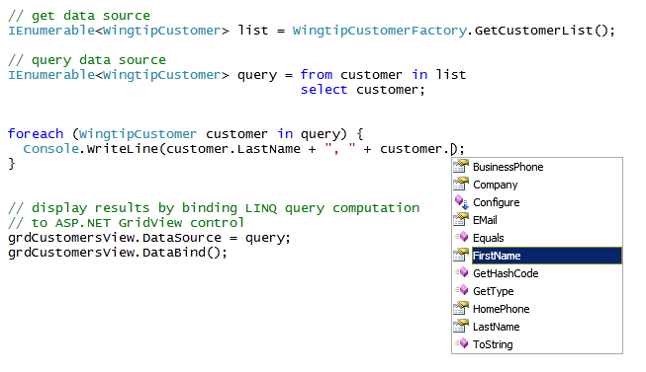

Querying Custom .NET Objects
Custom objects can be queried
  You still benefit from strong typing and IntelliSense
  ASP.NET GridView supports simple binding
Notes:
As collections of type IEnumerable<T> allow for collecting strongly typed objects, you can query and work with custom .NET objects using LINQ. The objects retrieved from the collection are still strongly typed and IntelliSense is available.

Slide 20
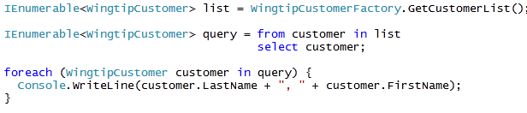
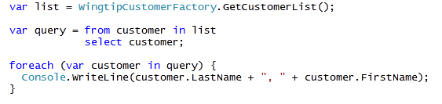

Type Inference and the var keyword
var keyword allows you to use type inference
  Compiler determines type being used by your code
  You still get strong typing and IntelliSense
this code can be rewritten using var keyword
using var can make code more concise, more adaptable and more readable
hover mouse over var keyword to see type
Notes:
Another useful feature of LINQ is the use ofType Inference. Type Inference allows the compiler to decide the data type of a variable at run time. This can be useful when using variables of which you don't know the content type. In order to use Type Inference in C#, we are required to use the new keyword var.
The var keyword allows you to defer typing until you know the type of the object you are working with.

Slide 21
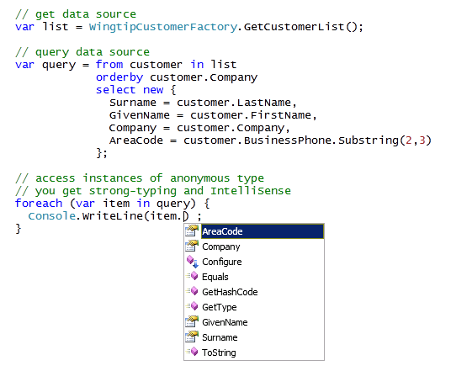


Projections using Anonymous Types
select clause can project an anonymous type
  Rename columns and create calculated columns
  No loss in type safety or IntelliSense
this anonymous class defines four properties
Notes:
Projection is the technique of taking a collection of one type, filter it and/or sort it, and then project a collection of a new type.The select extension method is what you use to implement projection on a collection. The new type is called an anonymous type.
Anonymous types provide a convenient way to encapsulate a set of read-only properties into a single object without having to first explicitly define a type. The type name is generated by the compiler and is not available at the source code level. Anonymous types are typically used in the select clause of a query expression to return a subset of the properties from each object in the source collection.
The select clause offers the ability to rename columns and to create calculated columns. The anonymous type declaration starts with the new keyword.

Slide 22
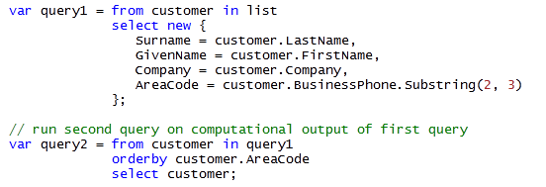

Query Composition
Queries can execute against output of others
  Allows for composition of queries
Notes:
Executing a LINQ query results in a new set of objects. This set can be used as the source for a second LINQ query.

Slide 23
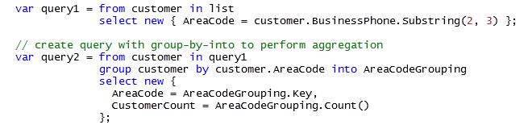
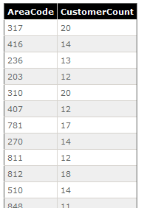
Grouping and Aggregation
LINQ support group by syntax
  Allows for aggregate operations (e.g. Count and Sum)
  Grouping create using into keyword
Notes:
Another extension method in LINQ is group by. Essentially, the clause is group the objects bya list of fields by which to group the records, then into followed by a list of aggregate expressions to calculate. In addition to aggregate expressions, the into clause can also contain the keyword new to create a new type of object.

Slide 24
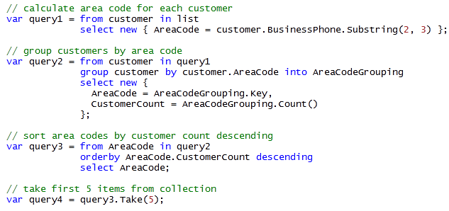
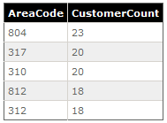
Putting it all together
Find the top 5 area codes by customer count
Notes:
This sample code executes a number of queries, each time returning a collection of objects of anonymous type, and serving as the source for the new query.

Slide 25
DEMO
Writing Query Expressions against
.NET Objects

Slide 26
Agenda
CAML
SPQuery & SPSiteDataQuery
LINQ Primer
LINQ to SharePoint

Slide 27
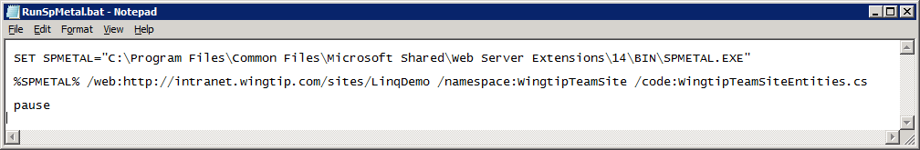
Creating Entity Classes with SPMETAL
SPMetal.exe essential to LINQ to SharePoint
  Command-line utility which is part of SharePoint install
  Used to generate strongly-typed entity classes
  Each entity class represents a SharePoint list
  SPMetal.exe also generates DataContext class
How do you use SPMetal.exe?
  Call it from a batch file and pass URL to site
  Take generated source file and add it to your project
Notes:
SharePoint 2010 comes with a LINQ provider for SharePoint called LINQ to SharePoint. You can use the SPMetal tool, which is a command line tool, to generate entity classes that provide an object oriented interface to the SharePoint content. Each entity class represents a SharePoint list.
SPMetal also generates a DataContext class.
The tool is included with SharePoint Foundation and is located in the\14\BIN folder. SPMetal accepts arguments like:
/web: specifies the URL to SharePoint site for which you want to generate entity classes.
/namespace: the namespace in which the entity classes will reside.
/code: the name of the class that will be generated.
You can copy the generated source file to your project folder and add it to your Visual Studio project. SPMetal generates partial classes, so that you can easily add methods and properties in separate code files, and do not have to modify the generated code.

Slide 28
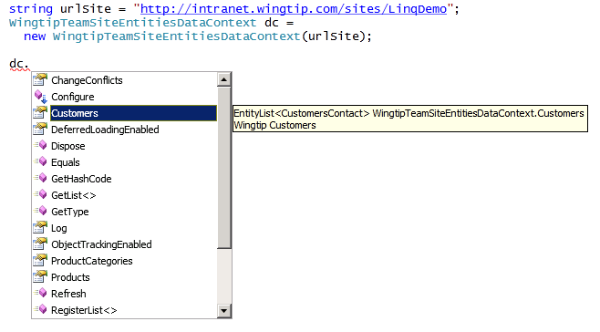
DataContext Object
DataContext represents connection to site
  Provides strongly-typed access to list as EntityList<>
Notes:
The heart of the Linq to SharePoint experience is the DataContext object. The DataContext object is retrieved from the SPWeb and allows access to the lists in the SPWeb.
Once entity classes are created, they may be used in LINQ queries. These classes are primarily used in LINQ to SharePoint queries, but they can also be used to add, delete, and change list items.

Slide 29
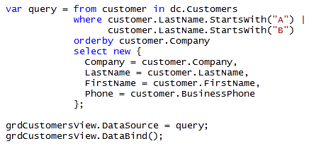
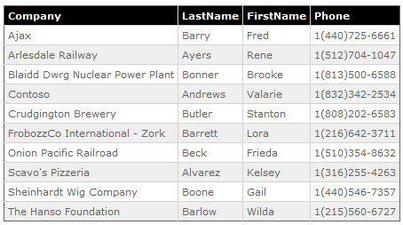
Querying Items in a List
Query list items using LINQ query expressions
Notes:
You can query the SharePoint content using LINQ queries. The sample code retrieves all customers having a last name starting with A or B. The orderby clause sorts the customers by company. The resulting objects will be of a trimmed version of the customer class, only containing the columns Company, LastName, FirstName and BusinessPhone.

Slide 30
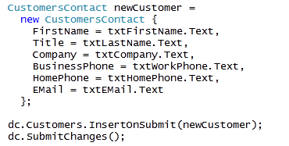
Adding Items to a List
Entity classes provide InsertOnSubmit method
  Method accepts strongly-typed entity class instance
  You must explicitly save changes through DataContext
Notes:
Entity classes provide anInsertOnSubmit method. This method accepts a strongly-typed entity class instance that represents the list item that needs to be created. You must call the SubmitChanges method to save the changes through the DataContext.

Slide 31
DEMO
Writing Query Expressions against
SharePoint Lists

Slide 32
Summary
CAML
SPQuery & SPSiteDataQuery
LINQ Primer
LINQ to SharePoint

